Slide 1
Evolution and Architectural Decay in OSS Projects
Dr Andrea Capiluppi
Senior Lecturer
University of East London
United Kingdom
Máster Universitario en Software Libre
Madrid – 11/03/2011

Slide 2
Outline of chapters
Of classic software evolution
Of “open source software life-cycle”
Of phases and forges
Transitions and phases: forges
Architectural restructuring
Where it all should be going to

Slide 3
Chapter 1 –
Of traditional software evolution

Slide 4
Models of evolution
Product perspective
Changed product
Detected
bugs
Corrected
bugs
Process perspective

Slide 5
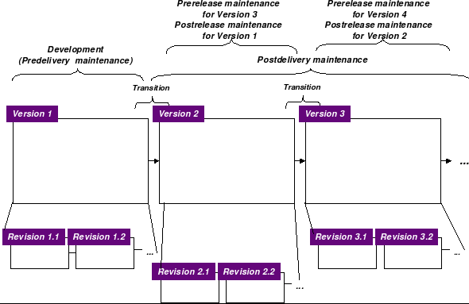
EM3 model
Mira Kajko-Mattsson – Evolution and Maintenance Management Model (EM3)

Slide 6
Program evolution dynamics
Program evolution dynamics is the study of the processes of system change.
Lehman and Belady proposed a number of ‘laws’ which applied to all systems as they evolved.
“sensible observations” rather than “laws”
  They are applicable to large systems developed by large organisations. Perhaps less applicable in other cases.

Slide 7
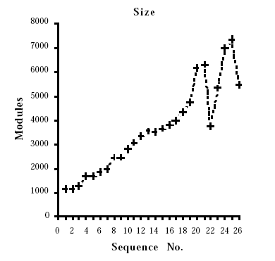
IBM OS/360-370

Slide 8
Applicability of Lehman’s laws
Lehman’s laws seem to be generally applicable to large, tailored systems developed by large organisations.
  It is not clear how they should be modified for:
  Systems that incorporate a significant number of COTS components;
  Small organisations;
  Medium sized systems.

Slide 9
Chapter 2 –
Of “open source software life-cycle”

Slide 10
A staged model for software life-cycle
F. Lehner, “Software Life Cycle
Management Based on
a Method for Phase Distinction"
Euromicro J., Aug. 1991,
pp. 603–608.
M.M. Lehman, "Program Evolution",
Academic Press, London, 1985.
V.T. Rajlich, K.H. Bennett, "A Staged
Model for the Software Life Cycle",
Computer, 33(7):66–71, 2000.

Slide 11
Giant's shoulders
V.T. Rajlich, K.H. Bennett, "A Staged
Model for the Software Life Cycle",
Computer, 33(7):66–71, 2000.
Papers,
experiences,
empirical results
Adaptation of the
Software Life-Cycle
as applied to FLOSS

Slide 12
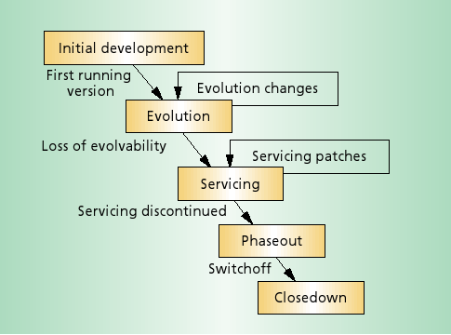
Staged Model – original formulation
K. Bennett, V. Rajlich, "Software Evolution: A Road Map"
Proc. 17th International Conference on Software Maintenance
(ICSM'01), 2001.

Slide 13
Model augmented – Initial development
Recipients are:
  Users (T)
  Other developers (FLOSS)
Initial development is crucial in FLOSS
  Mostly documented by several papers on OSS evolution
  Classified as sub-linear, linear or super-linear
  Israel Herraiz, Jesus M. Gonzalez-Barahona, and Gregorio Robles. 2007. Towards a Theoretical Model for Software Growth. In Proceedings of the Fourth International Workshop on Mining Software Repositories (MSR '07).

Slide 14
Model augmented – Evolution changes
Several releases are perceived as
  Instability factor (T)
  Vitality (FLOSS)
Feedback is
  Change requests, bug signalling (T)
  Same, plus code patches (FLOSS)
Trends and patterns
  FLOSS evolution loop was found to be super-linear

Slide 15
Model augmented – Servicing
Transition to servicing is due to economic profitability (T)
Observed FLOSS systems appear to be in servicing stages, but recover

Slide 16
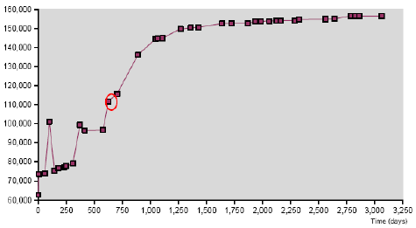
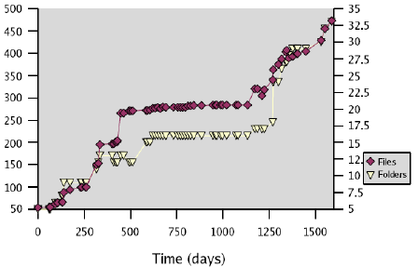
Servicing and recover

Slide 17
Model augmented – Phase Out
"Neither new functionalities nor changes are performed"
  Becomes a legacy application (T)
  Abandoned by the core team (FLOSS)
Empirical evidence of hand-over of FLOSS systems
  Renovation of core groups
  Presence of generations of developers

Slide 18
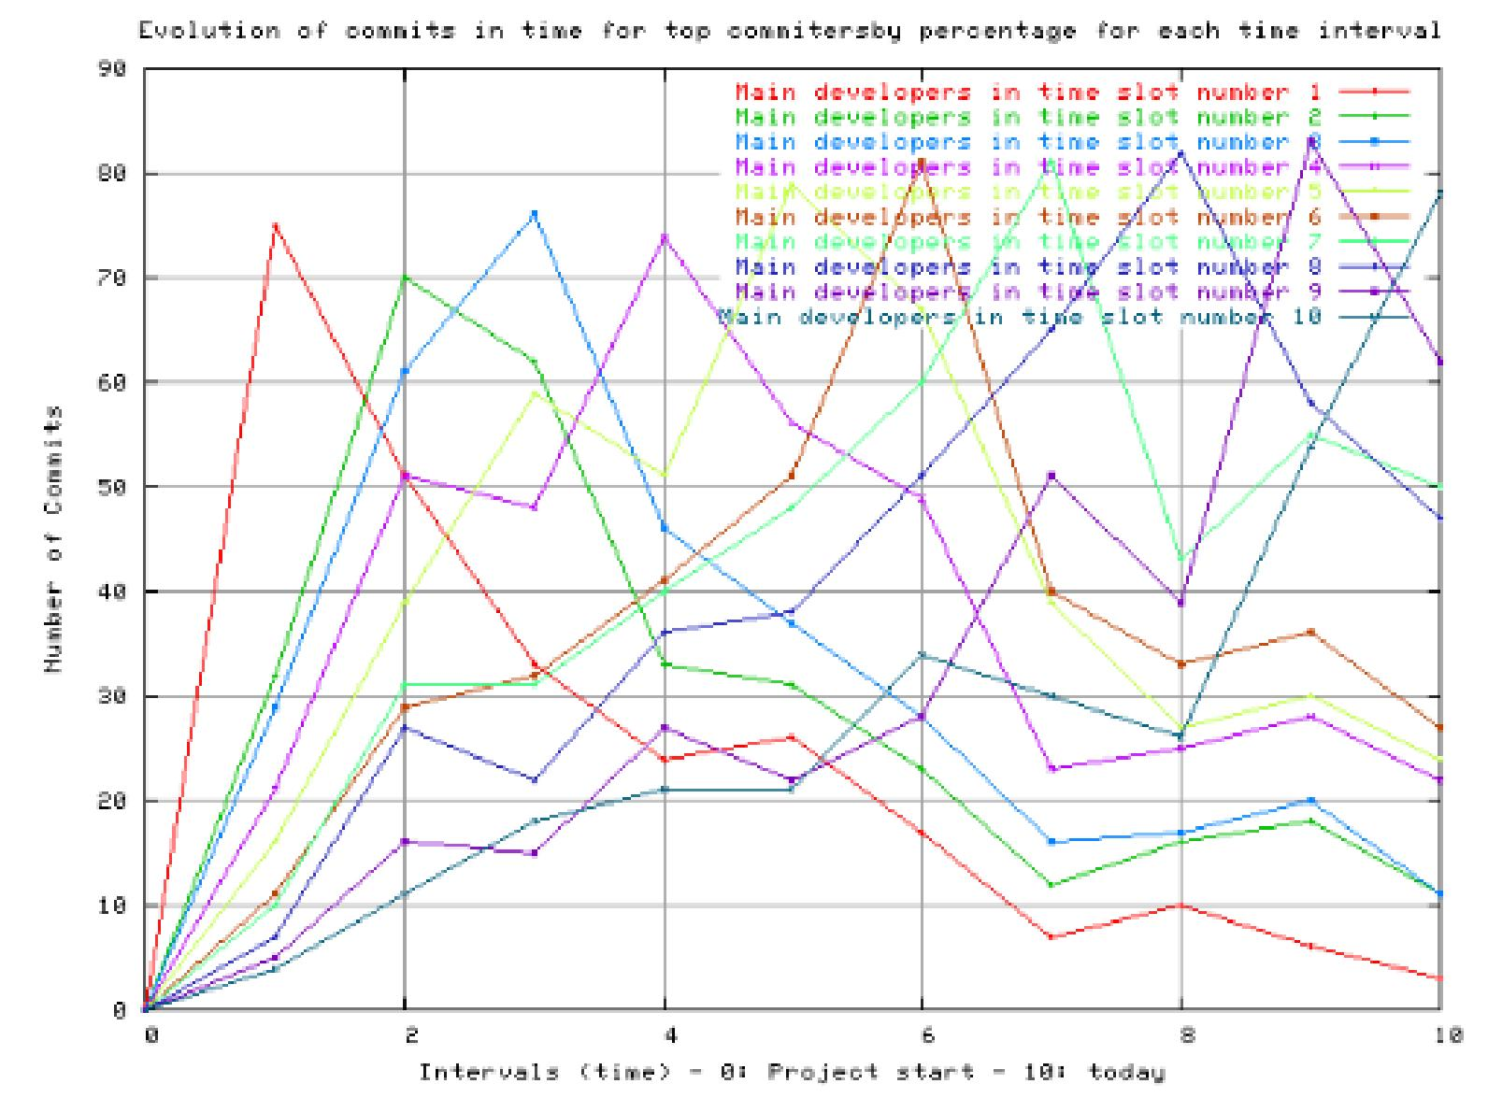
Generations

Slide 19
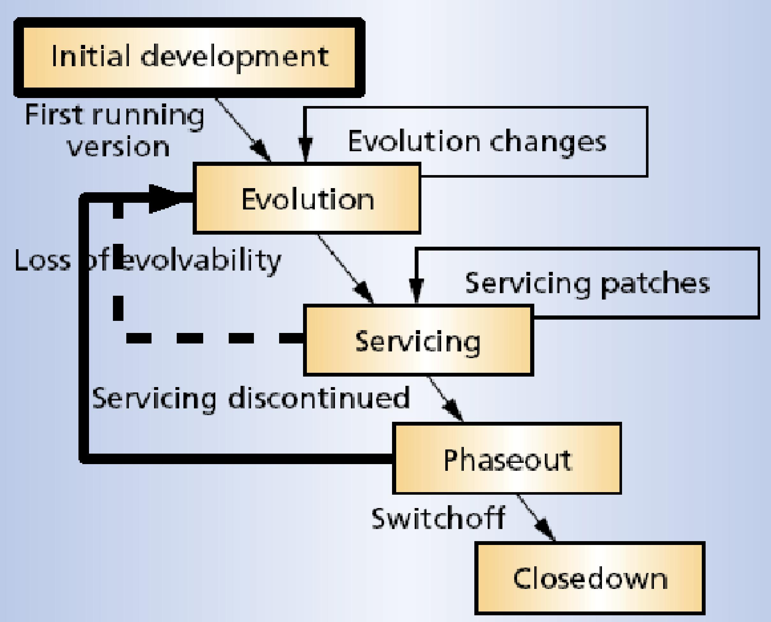
Model adapted to FLOSS

Slide 20
Relevant differences
Initial development
  "Building staff expertise is crucial" (T)
  FLOSS developers learn through code and discussions
Evolution to servicing
  "Revenues peak and start to fall" (T)
  Some FLOSS systems seem to recover (longer evolution dynamics)
Phase out
  FLOSS developers hand over code and documentation (longer evolution dynamics)

Slide 21
Chapter 2 –
Of phases in OSS projects

Slide 22
Terminology
Popular terms in the past (Raymond, 1999):
  Cathedral: closed approach, typical in most commercial systems
  Bazaar: open approach, the community at large is in charge of the whole system
The 'cathedral' and 'bazaar' are viewed as two opposed approaches
Eric S. Raymond. 1999. The Cathedral and the Bazaar (1st ed.). Tim O'Reilly (Ed.). O'Reilly & Associates, Inc., Sebastopol, CA, USA.

Slide 23
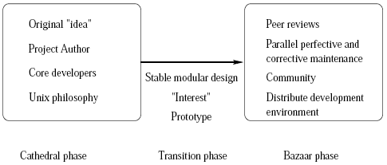
Background research: three phases
M. Michlmayr. Software process maturity and the success of free software projects. In K. Zielinski and T. Szmuc, editors, Software Engineering: Evolution and Emerging Technologies, pages 314, Krakow, Poland, 2005. IOS Press.

Slide 24
Case studies – Wine and Arla
Wine: tool to run Windows applications on Unix
  Large developer pool (overall, 880 distinct developers)
  Large activity detected (88,000 touches)
Arla: Networked File System
  slower recruitment of new developers (83 overall)
  smaller activity (7,000 touches)
Very different application domains!
  The study focuses on the mechanisms of forming communities, independent of AD's

Slide 25
Approach: goal, question, metrics
Goal: successful OSS projects achieve a transition through pro-active behaviour of developers
Questions:
1) only `bazaar' phases have growing input provided and output produced
2) new developers tend to work on newest modules first
Metrics: number of distinct developers per period (month, week, etc); activity on distinct modules per period

Slide 26
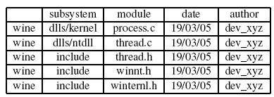
Summary of hypotheses
Distinct
touches
(output
produced)
Distinct authors
(input provided)

Slide 27
The Cathedral Phase

Slide 28
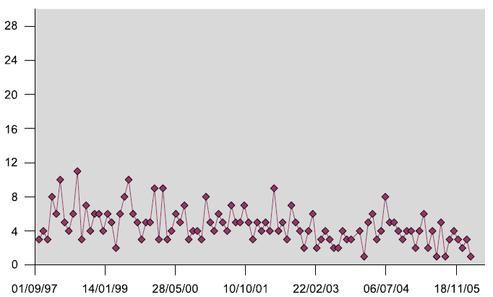
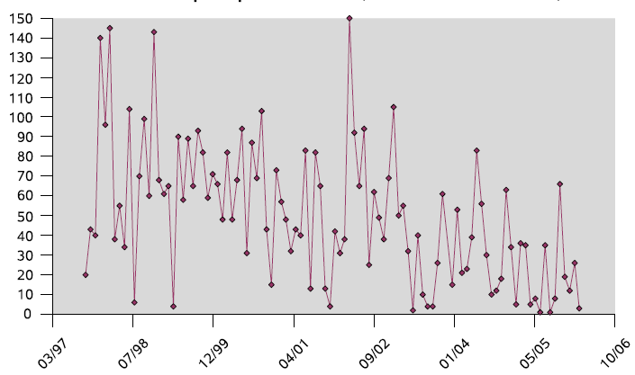
Arla – input and output
On average, only 5 developers worked on the system per month
Output is not increasing, and a decreasing trend (with spikes) is detected

Slide 29
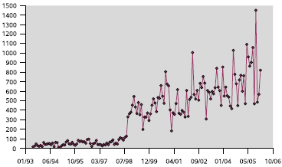
Wine – output (phase I)

Slide 30
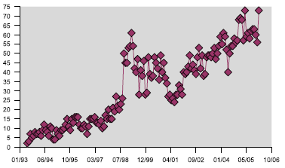
Wine – input (phase I)

Slide 31
The Bazaar Phase

Slide 32
Wine – input (phase II)

Slide 33
Wine – output (phase II)

Slide 34
The Transition Phase

Slide 35
Transition phase
Bazaar projects are the successful ones, but cathedrals are not failures
  Potentially, every cathedral can become a bazaar
  Accommodating the transition is a phase in itself
  Core developers should consider specific (pro-)actions
  Actions towards the recruitment of new developers
Our approach: detect what new developers do in these two projects

Slide 36
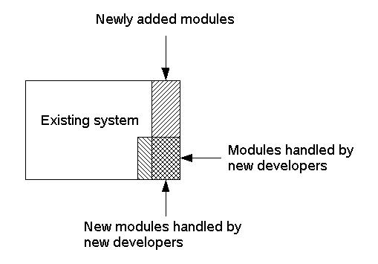
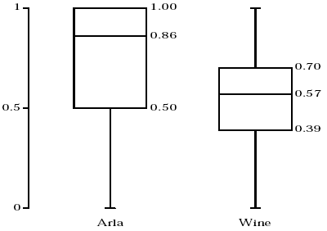
Detecting activities of new developers
Developers in both systems (both mostly in Arla) look eager to work on newer modules

Slide 37
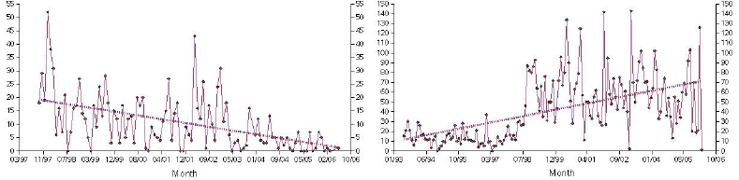
Creating new avenues of development
In Arla, core developers could not attract new developers (also) because fewer new modules were added
In Wine, newer modules attracted new developers

Slide 38
Lessons learned
The `cathedral' and `bazaar' phases, as initially proposed and depicted by Raymond, are not mutually exclusive
OSS projects start out in the cathedral phase, and potentially move to a bazaar later
The transition between the two phases is a phase itself, to be accommodated by specific, active actions of the core developers

Slide 39
Chapter 3 –
Of phases and forges

Slide 40
Phases and forges
The evolvability of FLOSS systems is unevenly distributed: in SourceForge
  vast majority of projects is small,
  with few developers and
  does not go beyond the first public release
FLOSS repositories act as exogenous factors:
  low barrier to entry → lower evolvability
  stricter control of access (such as the Debian distribution) → more evolvable projects

Slide 41
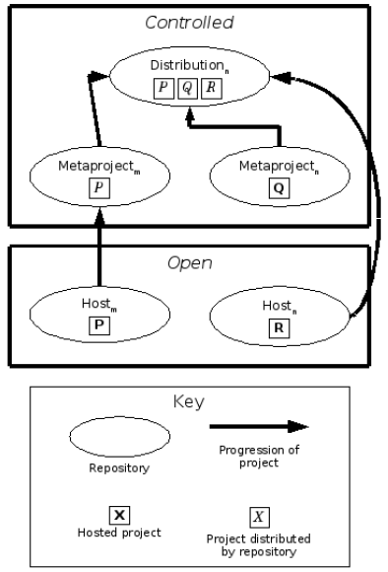
Transition between forges
Beecher, Karl and Capiluppi, Andrea and
Boldyreff, Cornelia (2009) Identifying
exogenous drivers and evolutionary stages
in FLOSS projects. Journal of Systems and
Software, 82 . pp. 739-750
Do projects in different forges present different complexity?
Are transitions helping in reducing complexity?

Slide 42
The Qualities of a Good Design
Fundamental principle of SD:
  A large system should be partitioned into manageable routines & modules
Goal:
  Routines are as independent as possible
  Each routine carries out a single problem related function
Measures
  Coupling and Cohesion

Slide 43
Coupling
One way to measure design quality is to use coupling
Measure of interdependence among modules
Objective: Minimise coupling, make routines as independent as possible
Low coupling => well-partitioned system

Slide 44
How to measure it
Coupling: the degree to which each source element relies on other elements
  Granularity: function calls (and method invocations)
  inbound (c_in)
  outbound (c_out)
cohesion
Element
c_in

Slide 45

Definitions – II
Instability (I): resilience to change of software components
  range is 0 to 1
  I = 0, lowest instability
  I = 1, completely unstable element

Slide 46
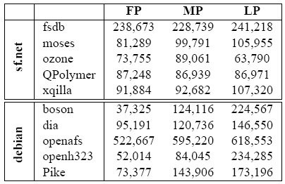
Growth in size (SLOCs)
Notes:
Highlighted the largest jumps in size and the very large projects in the sample, differently from SF they show more responsiveness in their evolution, even being so mastodontic

Slide 47
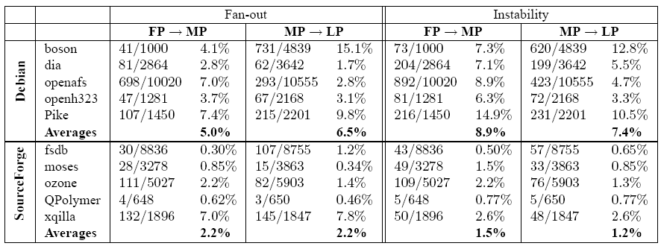
Anti-regressive work

Slide 48
Anti-regressive work – Results
Debian projects consistently receive greater architectural control work than SourceForge:
  FP → MP (5% against 2.2%)
  MP → LP (6.5% against 2.24%).
instabilities reflect this divide
  FP → MP (8.9% against 1.51%
  MP → LP (7.36% against 1.23%)
xqilla has recently been introduced into the unstable branch of Debian
  And it shows!

Slide 49
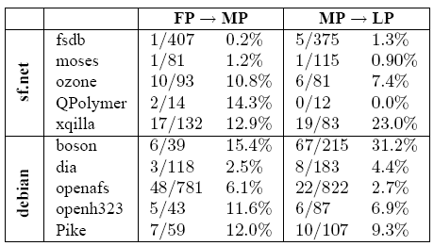
Excessive Fan-out (> 7) curbed

Slide 50
Chapter 4 –
Of architectural components and sampling issues

Slide 51
Problem Statement
Come avrai notato la presunta struttura di MPlayer è un bordello senza eguali...
Nicola Sabbi – MPlayer core developer
As you might have noticed, the so-called MPlayer architecture is an unprecedented mess...
Two of the aims on OSS research are
  Confirm whether similar systems share a common architecture
  Analyse whether this architecture changes over time

Slide 52
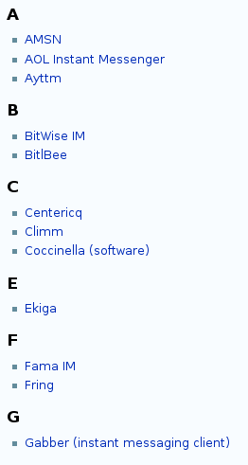
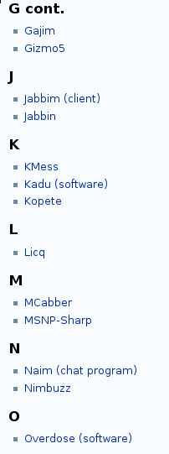
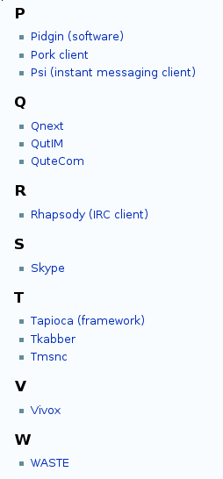
Duplication/Availability/Choice

Slide 53
Rationale
Studying FLOSS systems in *one*
  application domain
  type of software
  software need
Few studies based on architectures of FLOSS systems
Practically apply SE concepts to FLOSS systems

Slide 54
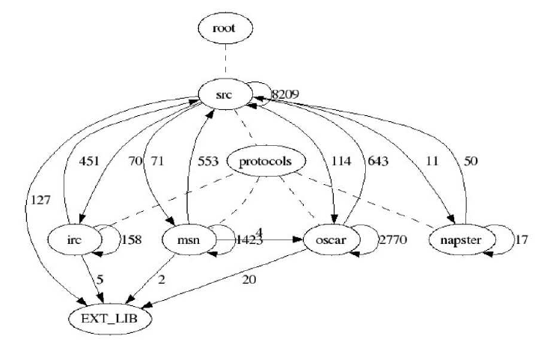
Physical and Modular architectures
Nodes
Coupling
Connections

Slide 55
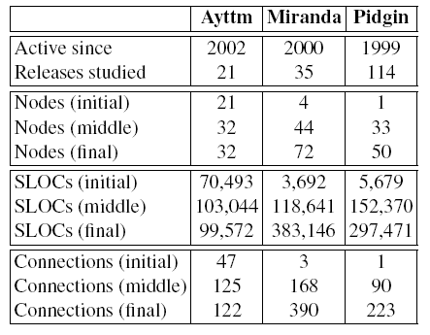
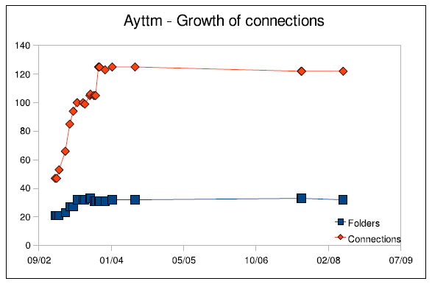
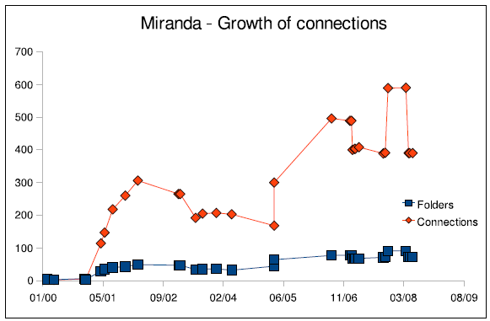
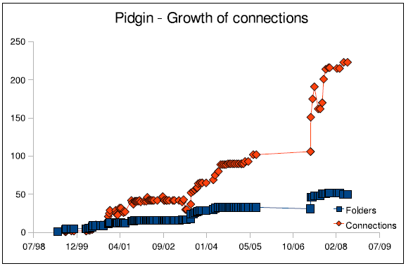
Case studies: Ayttm, Miranda, Pidgin
- All in C language
- Around 100 KSLOCs at
present

Slide 56
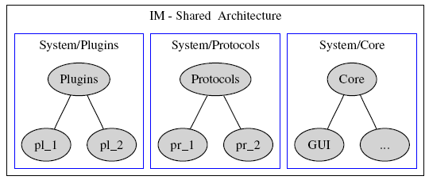
Results – Shared Architecture
Emerging common architecture
  scanning over 160 different versions of the software
  grouping similar functionality from within each version
  clustering the couplings

Slide 57
Architectural components
Core
  Connection to IM networks, handling of IM contacts, underlying GUI (server behaviour)
Protocols
  Yahoo, Jabber, MSN, etc.
Plugins
  GUI skins managers, connectors to email clients, etc.

Slide 58
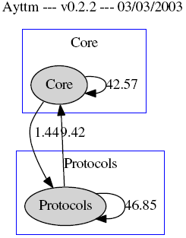
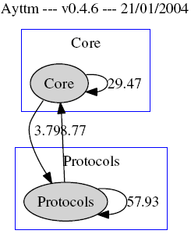
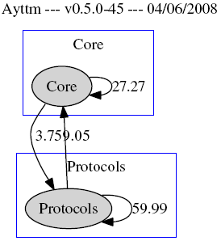
Results – Architectural decay
“Core” and “Protocols”
clearly formed
“Core” becomes more dependent on “Protocols”
Dependencies between components still relevant

Slide 59
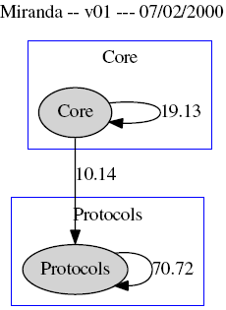
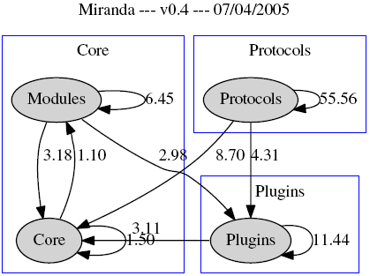
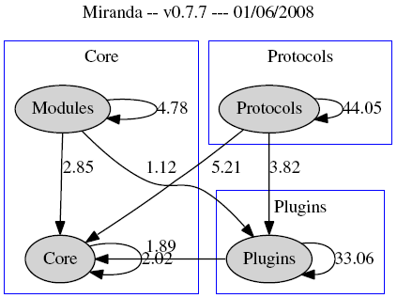
Results – Miranda
“Core” and “Protocols”
clearly formed, large dependencies
“Plugins” formed, “Core” reduce its dependencies
“Core” minimises its dependencies (1.12%)

Slide 60
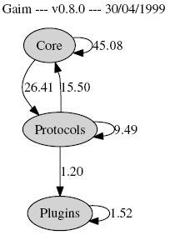
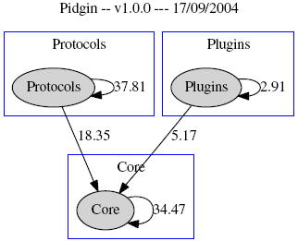
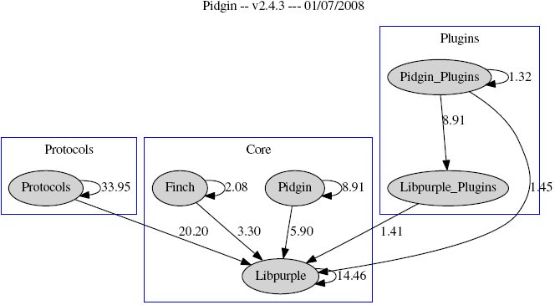
Results – Pidgin
Primitives, serious dependencies
(one Node)
Separation of concerns, self-contain-ment

Slide 61
Professional OSS code?
Eclipse is not purely Open Source, but “sponsored”

Slide 62
Professional standards

Slide 63
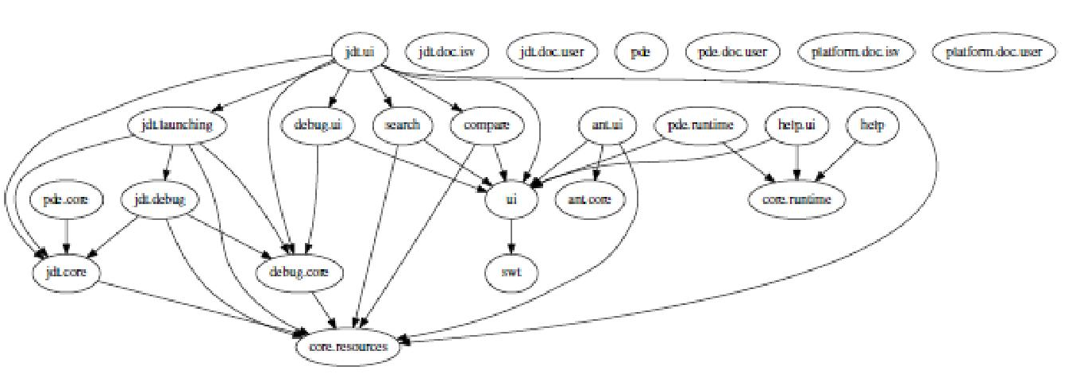
Professional standards

